Slide 1
Data science salaries analysis
Presented by: Fahd Ashraf
Last Updated: October 11th, 2022

Slide 2
Table of contents
Data Science Salaries
Data Science Salaries in 2020
Conclusion

Slide 3
What are we talking about ?

Slide 4
Objective
Find out Data science positions salaries and it’s highest paid job titles across the globe

Slide 5
Data Visualization

Slide 6
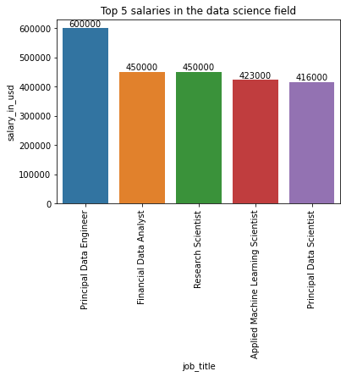
Top salaries in Data science field
Principal Data engineers get paid the most in the data science field at a 600000 USD / year
Financial data analysts come second and research scientists come third

Slide 7
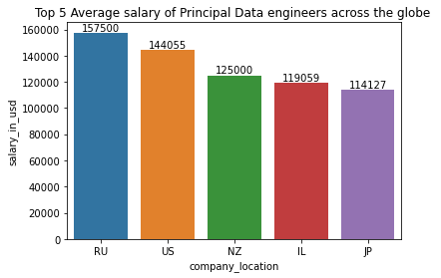
Highest salaries for Principal data engineers
The average salary for a principal data engineer is 157500 in Russia while in the US is 144055

Slide 8
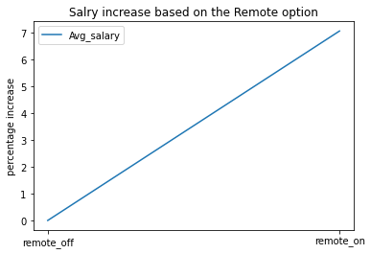
Salaries with remote option included
We can see that remote jobs in the field of data science has larger salaries by 7% than when the jobs are office based

Slide 9
Conclusion

Slide 10
Conclusion
Principal Data engineers get paid the most in the data science field followed by financial data analysts and research scientists
The average salary of data engineers in Russia is the highest in the world, comes after it the US
The average salary in data science field is increased by 7% when hiring remotely

Slide 11
Thank you

